Slide 1
Machine Learning Clustering
Affinity Propagation
Mean Shift
DBSCAN
Spectral Clustering
OPTICS
BIRCH

Slide 2

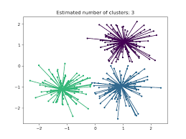
Affinity Propagataion
Introduction
Affinity propagation creates clusters by sending messages between data points to find the best exemplar.

Slide 3
Working of Affinity Propagation
Each point in the dataset is considered as a cluster
Datapoints exchange two messages-
Responsibility[r( i , k)]-It is the accumulated evidence that sample k should be the exemplar of sample i.
Availability[a( i , k) ] -It is the accumulated evidence that sample i should choose sample k to be its exemplar and considers the values for all other samples that k should be an exemplar.
Messages are updated until they converge.
This Algorithm selects the exemplars and forms clusters with nearby points.

Slide 4
Advantages of Affinity Propagation
Unlike K-Means don’t have to predefine the number of clusters.
It handles outliers.
Disadvantages of Affinity Propagation
It is slow for large datasets.
High memory usage.

Slide 5
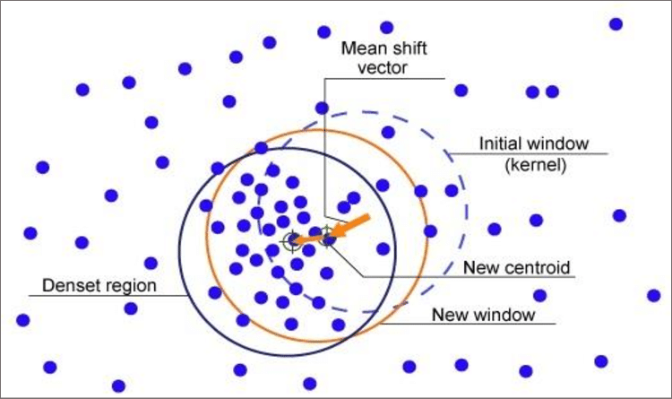
Mean Shift Clustering
Introduction
Mean Shift is a clustering algorithm that groups data points based on density.
It doesn't need the number of clusters to be specified.

Slide 6
Working of Mean Shift
Start with a random point.
Use a bandwidth(window) to find nearby points(usually circular).
Calculate the mean of the points inside the window.
Move the window to the mean position.
Repeat the steps until the window converges (stabilizes at a point).
Repeat for all points to identify dense regions (clusters).

Slide 7
Advantages of Mean Shift
No need to specify number of clusters (unlike K-Means).
Robust to outliers as it focuses on dense areas.
Disadvantages of Mean Shift
Does not scale well to very large datasets.

Slide 8
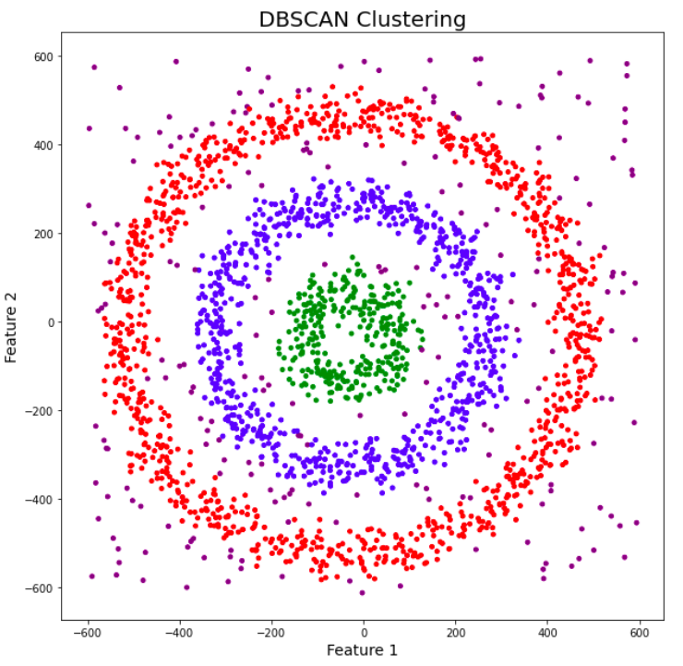
DBSCAN
Introduction:
DBSCAN(Density Based Spatial Clustering of Applications with Noise) is a clustering algorithm that groups datapoints based on the density.
It is effective at identifying and removing the noise in the dataset.

Slide 9
There are two parameters used
ε(epsilon)-It is the radius used to define a neighborhood around a point.
MinPts - MinPts is the minimum number of points required (including the point itself) to form a dense region, which can be considered a cluster.

Slide 10
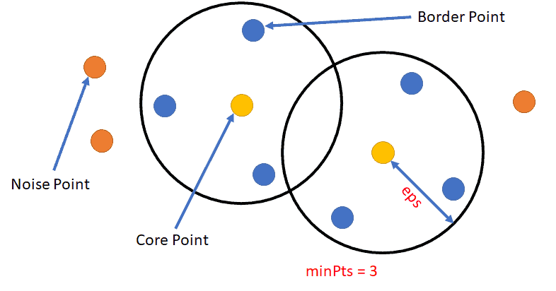
Working of DBSCAN
Start with any unvisited point
Find all points within the ε (epsilon ) radius –this forms the point’s neighborhood.
Check how many points are in the neighborhood
If the number of neighboring points is greater than or equal to MinPts , then it is a core point and new cluster is started.
If the number of neighboring points is less than the MinPts , and the point does not belong to the core point , then it is a noise.
If the number of neighboring point is less than MinPts and the point lies within the neighborhood of a core point , then it is a border point.
Repeat until all points are visited.

Slide 11
Advantages of DBSCAN
No need to specify the number of clusters.
Handles outliers.
Disadvantages of DBSCAN
Struggles with high dimensionality data.
Difficulty with clusters of varying densities.

Slide 12
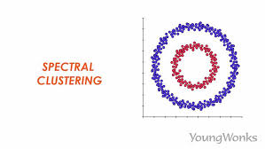
Spectral Clustering
Introduction
Spectral clustering algorithm groups data using similarity graph where each datapoint is a node and edges represent the similarity between points.
It uses eigen values and eigen vectors to transform the data into a new space where clusters are more easily separable.

Slide 13
Working of Spectral Clustering
Calculate Similarity matrix.
Construct a graph from similarity matrix ,where the nodes represents datapoints and the edges represents similarity values between them.
Compute Eigen values and Eigen Vectors to form a new low-dimensional representation of the data.
Apply clustering algorithm to group the data into clusters.

Slide 14
Advantages of Spectral Clustering
Works well for non-convex clusters.
Uses graph-based approach.
Disadvantages of Spectral Clustering
Requires Predefining the number of clusters.
Computationally expensive.
Not scalable for large datasets.

Slide 15
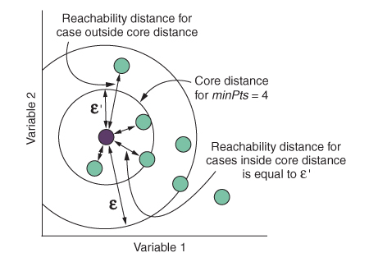
OPTICS
Introduction
OPTICS(Ordering Points to Identify the Clustering Structure) is a density-based clustering algorithm, similar to DBSCAN.
The key difference between DBSCAN and OPTICS is that the OPTICS algorithm builds a reachability graph.

Slide 16
Working of OPTICS
Calculate distance between all points.
Two parameters used in OPTICS
minpts-minimum number of points to form a dense region.
max_eps-It is the maximum radius used to search for the neighboring points.
Calculated Core Distance and Reachability Distance
Ordering the points and add to the queue.
Plot Reachability distances.
Clusters are formed.

Slide 17
Advantages of OPTICS
Handles clusters with varying density better than DBSCAN.
Detects outliers.
Disadvantages of OPTICS
Computationally expensive.

Slide 18
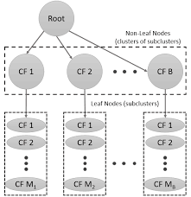
BIRCH
Introduction
Balanced Iterative Reducing and Clustering using Hierarchies.
Birch builds a tree called Clustering Feature Tree(CFT) for the given data.
CF tree holds the necessary information for clustering which prevents the need to hold the entire input data in memory.
This information includes:
Number of samples.
Linear Sum.
Squared Sum.
Centroids.

Slide 19
There are two parameters for constructing CF tree.
Branching factor-defines the maximum number of subclusters that a node can hold.
Threshold-defines the maximum distance between a new sample and nearest existing subcluster.

Slide 20
Working of BIRCH Algorithm
Each data point is inserted into the CF Tree.
BIRCH tries to add the new point to the existing cluster if it satisfies the threshold.
If no suitable cluster is found, a new cluster is created.
If a leaf node exceeds its branching factor , it is split into further leaf nodes.
Through this process the clusters are formed.

Slide 21
Advantages of BIRCH Clustering
Handles very large datasets.
Handles Outliers.
Memory Efficient.
Disadvantages of BIRCH Clustering
Suitable for Spherical clusters and may struggke with datasets containing clusters of complex shapes.

